Slide 1
Natural Language Processing
DSA4020
Edward Ombui, PhD

Slide 2
Course Description
This course is an introduction to Natural Language Processing (NLP), a critical field within artificial intelligence that focuses on enabling machines to understand, interpret, and generate human language.
Students will explore key concepts such as text preprocessing, language modeling, part-of-speech tagging, syntactic and semantic analysis, machine translation, and advanced neural network techniques.
The course emphasizes both theoretical foundations and practical applications, equipping students with the skills to tackle real-world NLP challenges.

Slide 3
Course Learning Outcomes
By the end of the course, the student should be able to:
Master Text Processing Techniques: Demonstrate proficiency in essential text preprocessing techniques, including tokenization, stop words removal, stemming, lemmatization, and normalization, to prepare raw text data for NLP tasks.
Apply Language Models and Parsing: Develop and implement language models, such as n-grams and Hidden Markov Models (HMMs), and apply syntactic parsing techniques using Context-Free Grammars (CFG) to analyze and generate natural language structures.
Build and Evaluate NLP Systems: Design, build, and evaluate NLP systems for tasks like sentiment analysis, machine translation, and named entity recognition using both traditional methods and advanced neural network architectures, including RNNs, LSTMs, and Transformers.
Address Ethical and Bias Challenges in NLP: Critically assess ethical issues and biases in NLP models and applications, and propose strategies to ensure fairness, accountability, and transparency in the development and deployment of NLP systems.

Slide 4
Weekly Course Topics
Week | Topic
Week 1 | Introduction to Natural Language Processing
Week 2 | Text Preprocessing
Week 3 | Language Modeling
Week 4 | Part-of-Speech Tagging
Week 5 | Syntax and Parsing
Week 6 | Semantics
Week 7 | MID - SEMESTER EXAMINATION
Week 8 | Machine Translation
Week 9 | Information Retrieval and Text Mining
Week 10 | Sequence Labeling and Named Entity Recognition (NER)
Week 11 | Topic Modeling
Week 12 | Advanced Neural Networks for NLP
Week 13 | Ethics and Bias in NLP
Week 14 | FINAL SEMSTER EXAMINATION

Slide 5
Course Assessment
Class Attendance and Participation 10% Labs and Assignments 25% Term Project 15% Mid-Semester Examination 20% Final Examination 30% Total 100%

Slide 6
Course Text
Jurafsky, D., & Martin, J. H. (2023). Speech and language processing (3rd ed.). Pearson.
Eisenstein, J. (2019). Introduction to natural language processing. MIT Press.
Reference Textbooks
Steven Bird, Ewan Klein, and Edward Loper (2009), Natural Language Processing with Python - Analyzing Text with the Natural Language Toolkit. Online. Url: http://www.nltk.org/book_1ed/
Benjamin Bengfort , Rebecca Bilbro , Tony Ojeda (2018). Applied Text Analysis with Python: Enabling LanguageAware Data Products with Machine Learning

Slide 7
Week 1

Slide 8
Introduction to Natural Language Processing
Week 1

Slide 9
Introduction
At the end of this week’s lessons you should be able to:
Understand the basic concepts and scope of NLP.
Identify key challenges in processing natural language.
Recognize the importance of NLP in modern technology and applications.

Slide 10
What is Natural Language Processing?
Natural language : a language that is used for everyday communication by humans e.g. Kiswahili, English, Kinyarwanda, Xhosa, Yoruba, Amharic, etc
Artificial Languages: e.g. programming languages and mathematical notations
NLP: Teaching computers to manipulate or understand human language
Manipulate : it could be as simple as counting word frequencies to comparing different writing styles
Understand of human utterances and giving useful responses
NLP is also known by the name of "Computational Linguistics.“
Applications: Google search by voice, Machine translation, handwriting recognition etc
Notes:
Natural languages have evolved as they pass from generation to generation, and are hard to pin down with explicit rules

Slide 11
History and Evolution of NLP
Early Beginnings (1950s-1960s)
1950: Alan Turing's paper "Computing Machinery and Intelligence" introduces the Turing Test, sparking interest in machine language understanding.
1954: Georgetown-IBM experiment demonstrates early Russian-to-English translation, using rule-based systems and symbolic approaches.
1960s: NLP focuses on manually crafted rules and dictionaries for language processing, with limited success in automating language tasks.
Statistical Methods and Machine Learning (1980s-1990s)
1980s: Shift from rule-based to statistical methods, leveraging probabilistic models like Hidden Markov Models (HMMs) for tasks such as part-of-speech tagging and speech recognition.
Machine Learning: Emergence of machine learning techniques, allowing models to be trained on large datasets to learn language patterns automatically.
Vector Space Model: Introduction of the vector space model for information retrieval and early statistical machine translation systems, exemplified by IBM's models.
The Deep Learning Revolution (2010s-Present)
2010s: Deep learning transforms NLP, significantly improving performance across tasks.
Word Embeddings: Development of Word2Vec, GloVe, and other embeddings that capture semantic relationships in continuous vector spaces.
RNNs and LSTMs: Adoption of Recurrent Neural Networks (RNNs) and Long Short-Term Memory (LSTM) networks for sequence modeling, enhancing tasks like language translation and sentiment analysis.
Transformers: Introduction of attention mechanisms and Transformer models (e.g., BERT, GPT), revolutionizing language understanding and generation with superior accuracy.
Notes:
Linguistics is the scientific study of language. It involves the analysis of language form, language meaning, and language in context. Linguists traditionally analyse human language by observing an interplay between sound and meaning.

Slide 12
Current Trends and Future Directions
Research Focus: Ongoing research aims to improve model efficiency, address low-resource languages, and tackle ethical issues like bias and fairness in NLP models.
Integration with AI: Increasing integration of NLP with other AI domains, such as computer vision and robotics, to develop more sophisticated AI systems.
Impact: NLP's growing presence in applications such as virtual assistants and automated content generation highlights its expanding role in human-computer interaction.

Slide 13
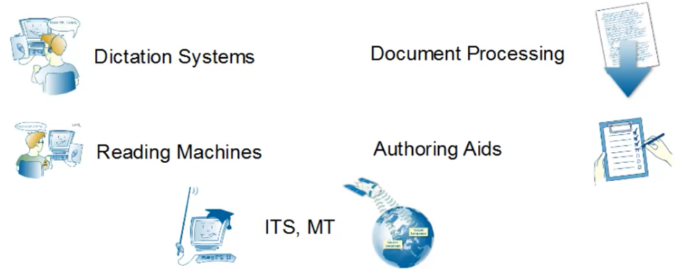
Applications
Provides communities with fonts and keyboard setups to process data in their languages through computers or mobile devices
Question Answering
Summarization
Information extraction
Dialogue and Conversational Agents
Speech-to-Text ; Text-to-Speech
Machine Translation,
Text mining and analytics.
Knowledge representations, etc
Notes:
Question Answering
Summarization
Information extraction
Dialogue and Conversational Agents
Speech-to-Text ; Text-to-Speech
Machine Translation, etc.

Slide 14
Research Areas
Characterizing Communicants: sentiment analysis
Context and content
Information extraction
Machine learning
Machine Translation
Speaker and language Identification
Spoken language applications
Speech recognition
Natural Language Processing, Computational Linguistics, Information Extraction, Summarization & Question Answering, Information Retrieval, Text Mining & Analytics, Knowledge Representation, Reasoning & Acquisition, Language Technologies for Education, Machine Learning, Machine Translation, Multimodal Computing and Interaction, Speech Processing, and Spoken Interfaces & Dialogue Processing.

Slide 15
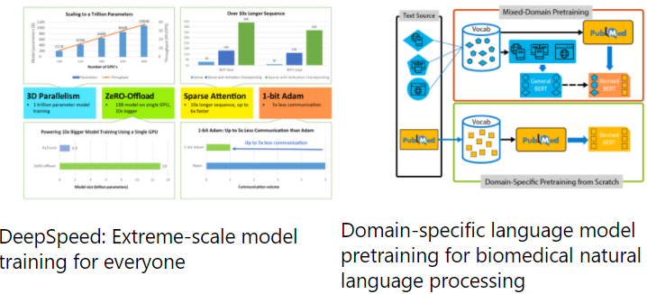


HLT Research by Microsoft
“Researching software and systems that bridge the linguistic divide between people and machines to make communicating with computers as natural as speaking with family and friends. ”
Notes:
https://www.microsoft.com/en-us/research/research-area/human-language-technologies/?facet%5Btax%5D%5Bmsr-research-area%5D%5B0%5D=13545&sort_by=most-recent

Slide 16
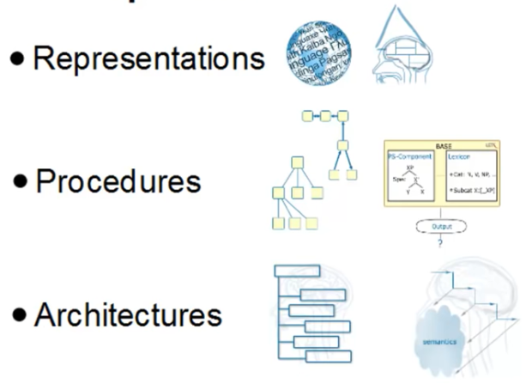
Computational Modeling
This is the heart of any system that does processing of natural languages
Comprises of
Notes:
Representations: encode background knowledge about the world. Grammars, and lexicon
Procedures: process of transforming input to output . E.g. Parsing, Generation, Translation
Architectures: Sequential, Parallel, or incremental

Slide 17
Key Challenges in NLP
Ambiguity in Language
Lexical ambiguity
Syntactic ambiguity
Semantic ambiguity
Handling low resource languages
Bias and fairness
Interpretability and explainability

Slide 18
Impact of technology on human language

Slide 19
Effects of technology on Languages
What are we doing differently now with the introduction of technology as compared to before?
Printing in the 15th century : variety of languages
Newspapers : introduction of cartoons etc
19 Century technologies
The Telephone: people did not know what to do when you pick a phone ( Hello?)
Broadcasting in 1920s
TV
Radio [Think of all things you can do on these medium]
Sports commentary
News reading
Weather forcasting

Slide 20
Key Historical developments
The Internet
Email;
WWW in 1991
Google search 1999
Text messaging
Blogging 1997
FaceBook 2004
YouTube 2005
Twitter 2006

Slide 21
Technology influencing how we Think?
New technologies resulting into new ways of communicating or language style e..g
Tech influences languages in specific ways e.g. text messaging and Twitting (160 , 140 characters i.e. 30 English words)
E..g Twitter prompts:
What are you doing?
What is happening ?
Software with the technology influences how we think

